Slide 1
CLASSROOM MANAGEMENT
MAINTAINING A POSITIVE SUNDAY SCHOOL ENVIRONMENT

Slide 2
Ways to prevent behavior issues from happening…..
Assign students where they should sit.
Be positive.
Remind children of the classroom expectations EACH week. Establish and be consistent with rules and behavioral expectations. Discuss consequences of violating expectations. Clearly display expectations and consequences.
Have a reward system to promote positive behavior. See the Sunday School website for ideas.

Slide 3
cont:
Get to know the children in your class as individuals.
Try to anticipate potential conflicts. Think through how you can prevent something from happening. Ex. one-on-one conversations with the child prior to the class.
Document behavior issues. If behavior continues, make an appoint to speak with the parent(s).
Make lessons that are engaging, interesting and age appropriate.
Be prepared and ready before the children come to the room.

Slide 4
Strategies for Managing Misbehavior
The following strategies are practical suggestions for managing misbehavior in the classroom. The strategies are listed in order of appropriateness from minor to major misbehaviors.

Slide 5
#1 - IGNORE IT
At times, ignoring a minor misbehavior is necessary so you are not interrupting the flow of the lesson. Be cautious when using this strategy. Ignoring may indicate to children that you are unaware of what is going on. Keep in mind the main goal is to deal with misbehavior in the least disruptive way possible.

Slide 6
#2- USE PROXIMITY
Minor misbehavior can often be taken care of before it becomes a major problem. One proactive measure is to circulate the room, using physical closeness to get children back on track.

Slide 7
#3- GIVE “THE LOOK”
Make use of facial expressions, eye contact, or hand signals while circulating the room to indicate to children you are aware of what is going on. Sometimes “pausing” is a clue that you are waiting for them to quiet down.

Slide 8
#4- USE VERBAL INTERVENTIONS
Sometimes, verbal interventions are necessary to direct children back to an activity. Use the child’s name and simply state what is expected.
If the misbehavior occurs during a group discussion or lesson, ask the child a question about the topic to re-direct him/her back in.
For older children, saying the child’s name is often enough to prompt the child to determine the appropriate behavior.

Slide 9
#5 - USE “I” MESSAGES
This is a form of a verbal prompt most effective with older children.
“I” messages contain three components:
a) Describe the unacceptable behavior in a non-blaming way: “When people talk while I’m giving directions...”
b) Describe the tangible effect this behavior has on you, the teacher:
“...I have to repeat the directions and that wastes time...”
c) State your feelings about the tangible effect: “...and I get frustrated.” “I” messages don’t put children on the defensive and students may be more willing to change their behavior.

Slide 10
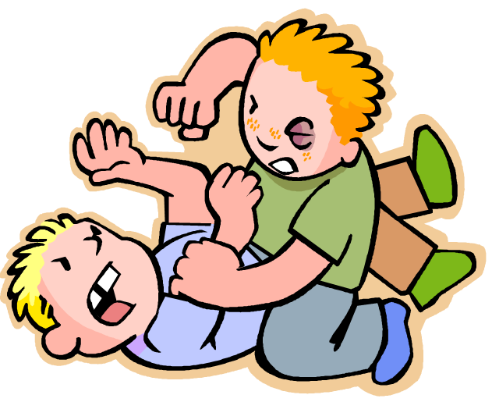
#6- ENFORCE A CONSEQUENCE
When non-verbal cues or verbal reminders are not enough, enforcing a consequence may be necessary.
There may be times when a child’s problems are so deeply rooted that the above strategies just won’t work. Requesting the help of Abouna or a coordinator may be necessary. Be sure to inform parents or guardians if a problem persists or can’t be dealt with. Documentation is key!

Slide 11
How to speak to the Parent(s)
The child should be present with you when speaking to the parent(s).
Start off with something positive about the child.
Be sympathetic and sincere.

